Slide 1

Windows Code Name
LONGHORN

Slide 3


9:30 PM
Thursday, April 30, 2020

Slide 4
9:30 PM
Thursday, April 30, 2020

Slide 5


9:30 PM
Thursday, April 30, 2020
Lipus Leo Leung
Welcome

Slide 6












Recycle Bin
This PC
Windows Longhorn Milestone 7 (Remake Version)
Evaluation Copy. Build 19041.ccptb4074_2004430-1050
9:30 PM

Slide 7











Recycle Bin
This PC
Lipus Leo Leung
Internet
Microsoft Edge
Office
Mail
Windows Mail
PowerPoint
Word
Excel
Calendar
Microsoft Store
OneDrive
OneNote
Life
Calendar
Photos
Mail
All Programs
Lock
Shut Down
Windows Longhorn Milestone 7 (Remake Version)
Evaluation Copy. Build 19041.ccptb4074_2004430-1050
9:30 PM

Slide 8
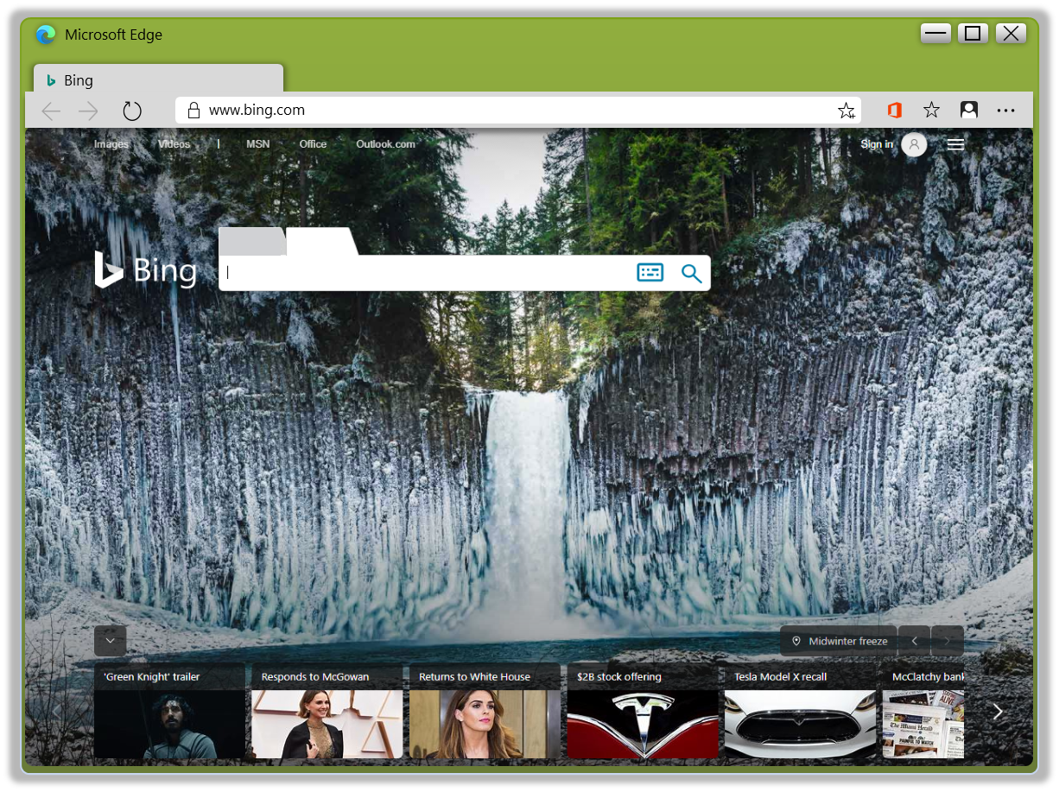
Recycle Bin
This PC
Windows Longhorn Milestone 7 (Remake Version)
Evaluation Copy. Build 19041.ccptb4074_2004430-1050
9:30 PM

Slide 9
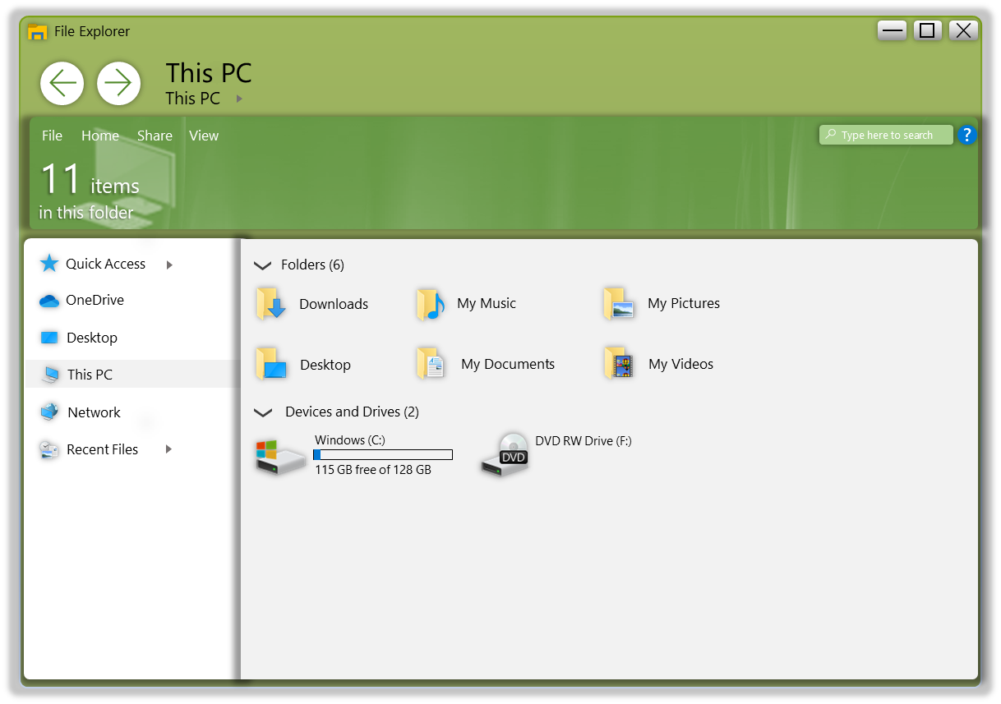
Recycle Bin
This PC
Windows Longhorn Milestone 7 (Remake Version)
Evaluation Copy. Build 19041.ccptb4074_2004430-1050
9:30 PM

Slide 10
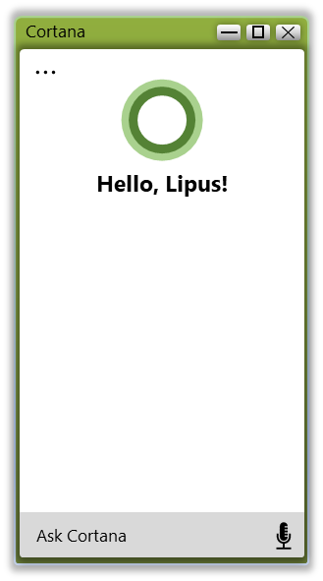
Recycle Bin
This PC
Windows Longhorn Milestone 7 (Remake Version)
Evaluation Copy. Build 19041.ccptb4074_2004430-1050
9:30 PM

Slide 11
Recycle Bin
This PC
Windows Longhorn Milestone 7 (Remake Version)
Evaluation Copy. Build 19041.ccptb4074_2004430-1050
8:03 AM

Slide 12


New Desktop
Recycle Bin
Now
Cortana
File Explorer
Microsoft Edge
This PC
Earlier Today
Godzilla –
Bing Images
CONCEPT 1.pptx
Plans.docx
Bing.com
PowerPoint
Word
Apr.12th
Apr.1st
Windows Longhorn Milestone 7 (Remake Version)
Evaluation Copy. Build 19041.ccptb4074_2004430-1050
9:30 PM

Slide 13
Recycle Bin
This PC
Windows Longhorn Milestone 7 (Remake Version)
Evaluation Copy. Build 19041.ccptb4074_2004430-1050
9:30 PM

Slide 14
Recycle Bin
This PC
Windows Longhorn Milestone 7 (Remake Version)
Evaluation Copy. Build 19041.ccptb4074_2004430-1050
9:30 PM

Slide 15
Recycle Bin
This PC
Windows Longhorn Milestone 7 (Remake Version)
Evaluation Copy. Build 19041.ccptb4074_2004430-1050
9:30 PM

Slide 16




Recycle Bin
This PC
Pictures
Documents
Settings
Videos
Top Apps
Mail
Calendar
Photos
Microsoft Edge
Recent Activities
Manage in Timeline
Godzilla – Bing Images
CONCEPT 1.pptx
Plans.docx
Type here to search
Windows Longhorn Milestone 7 (Remake Version)
Evaluation Copy. Build 19041.ccptb4074_2004430-1050
9:30 PM

Slide 17





Recycle Bin
Inbox - Outlook
Search
This PC
New mail
Focused
Others
Accounts
Outlook
example@outlook.com
Folders
No mail
Inbox
More
Windows Longhorn Milestone 7 (Remake Version)
Evaluation Copy. Build 19041.ccptb4074_2004430-1050
9:30 PM

Slide 18







Notifications
Recycle Bin
Microsoft Store (2)
Microsoft Edge (1)
This PC
Thursday
Apr.30th
29℃
Jiangcheng District, Guangdong
Expand
Windows Longhorn Milestone 7 (Remake Version)
Evaluation Copy. Build 19041.ccptb4074_2004430-1050
Tablet Mode
Bluetooth
Battery Server
9:30 PM

Slide 19
Recycle Bin
This PC
Windows Longhorn Milestone 7 (Remake Version)
Evaluation Copy. Build 19041.ccptb4074_2004430-1050
9:30 PM

Slide 20
Recycle Bin
This PC
Lipus Leo Leung
Internet
Microsoft Edge
Office
Mail
Windows Mail
PowerPoint
Word
Excel
Calendar
Microsoft Store
OneDrive
OneNote
Life
Calendar
Photos
Mail
All Programs
Lock
Shut Down
Windows Longhorn Milestone 7 (Remake Version)
Evaluation Copy. Build 19041.ccptb4074_2004430-1050
9:30 PM

Slide 21
9:30 PM
Thursday, April 30, 2020
Shutting Down

Slide 22
Windows Code Name
LONGHORN
CONCEPT

Slide 23
Windows Code Name
LONGHORN
CONCEPT

Slide 24
Windows Code Name
LONGHORN
CONCEPT

